Slide 1
Dammit Doll Simulator
2020 Spring Computer Graphics
지 곡 동 피 주 먹
김기홍 (20192913)
이다진 (20202889)
이영규 (20202755)

Slide 2
Introduction

Slide 3
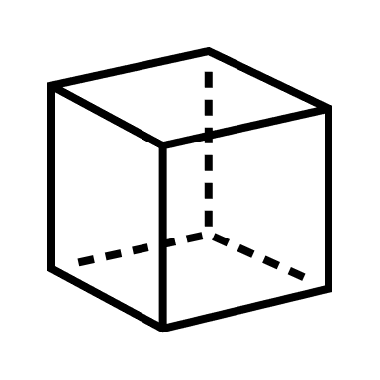
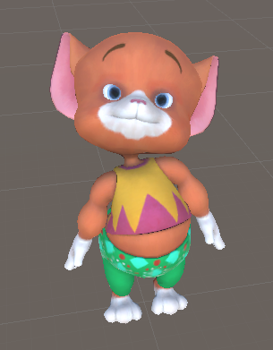



Previous Project Goal
Simulation of stress relief doll composed of various materials
Material effects
Fluid - MPM
Jelly, Beads – Particle System
Mouse interaction in cubic space
Throwing
Cutting
Fluid
Jelly
Bead

Slide 4
Plan & Modification

Slide 5
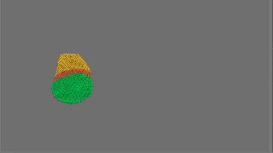
Body Part - Jelly
MPM(Material Point Method)
Algorithm for simulating deformable object using particle and grid calculation
Drawback
Visual-only rendering
Hard to interact
Low visual quality

Slide 6
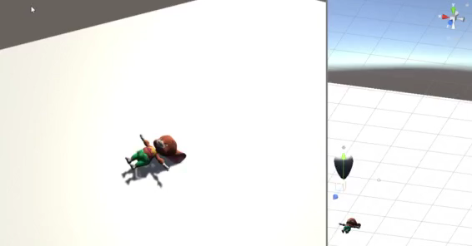
Body Part - Jelly
Mesh Deformer
Direct interaction with mesh collider of object
Easy to make other interaction effect(throwing, cutting)

Slide 7
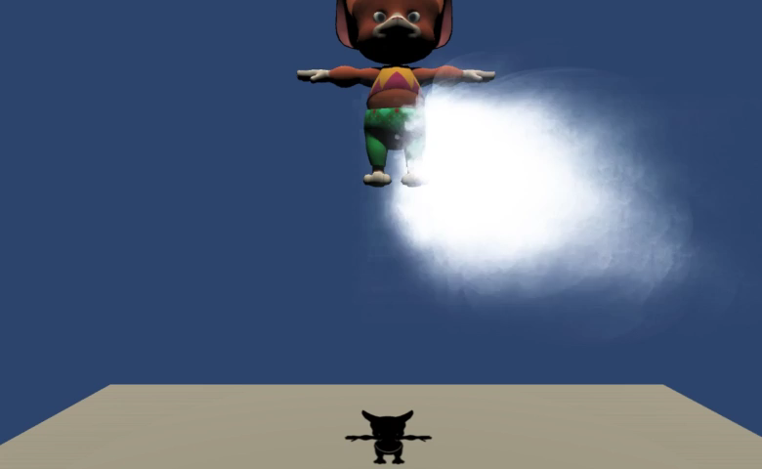
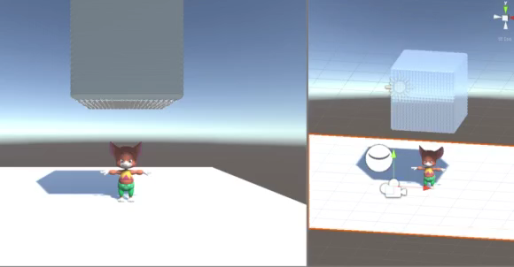
Body Part - Fluid
Particle system
Bursting effects of water balloon shaped body part
NVIDIA FleX
Particle-based method similar to MPM
Provide physical formula for various material
More appropriate method for visual satisfaction

Slide 8
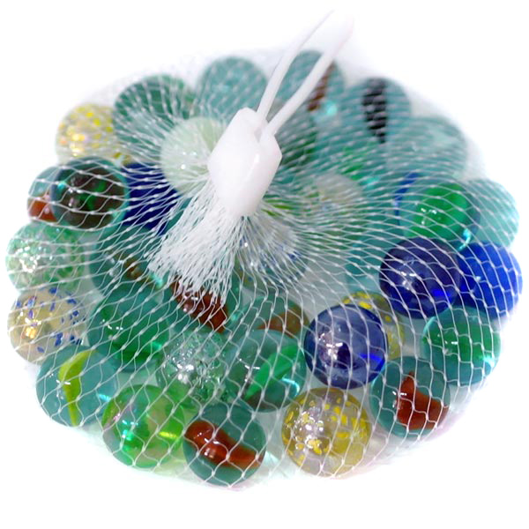
Body Part - Bead
Particle system
Creating too many objects
Inappropriate for bead’s sparse material effects
Creating a few practical object
Bursting effects of bead-filled sack

Slide 9

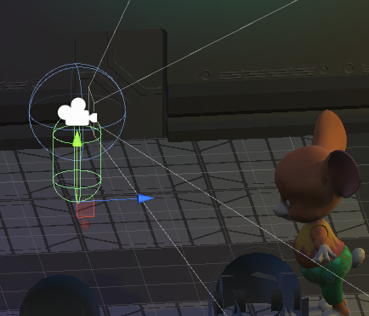





Interaction
Keyboard
WASD – Movement of player
Mouse
Camera translation
Ray Casting – object designation, trajectory setting
Left Drag – Rigid body throwing
Right Drag – Mesh cutting

Slide 10
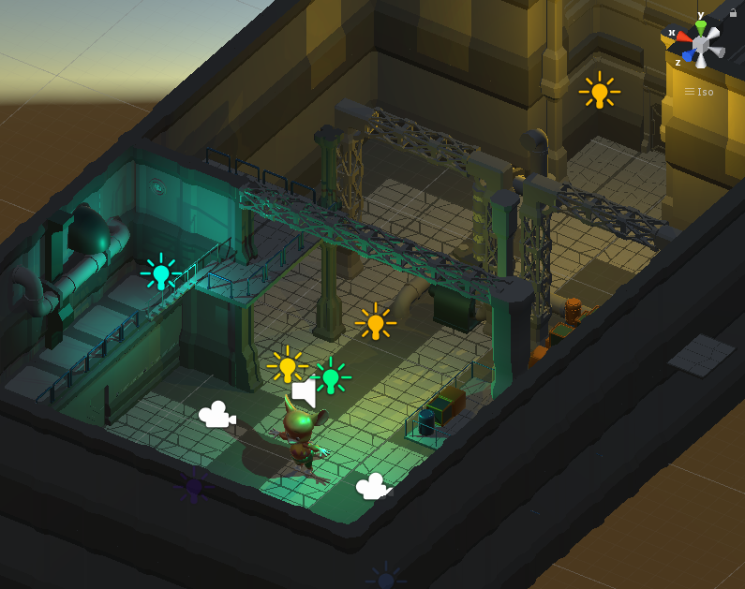
Interaction Space
Utilize Unity asset
Making interaction with surrounding object
Adjust lighting for spooky scenario context

Slide 11
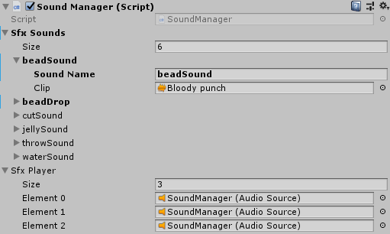
Sound Effects (*)
SoundManager Unity script
BGM
Throwing sound
Cutting sound
Object collision sound – Jelly, Beads
Water bursting sound

Slide 12
Demo
Notes:
앞서 말씀드린 개발내용들을 종합하여 dammit doll simulator를 완성하였고
데모 영상을 보면서 프로젝트의 중점 목표들을 어떻게 구현했는지 간단히 정리하고 마치도록 하겠습니다.

Slide 13
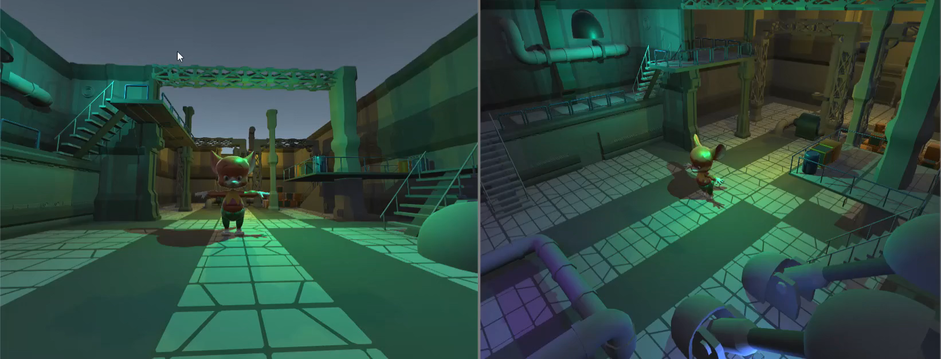
Demo Video

Slide 14
Q&A
Thank you

